Slide 1

STRENGTHENING OF STEEL BY CHANGING THE ELEMENTS
CHROMIUM, MANGANESE AND NICKEL ELEMENTS.
Presented by
SAKINALA. RAJU – 20011D8916
MECHANICAL ENGINEERING- MTECH(PTPG)- ENGINEERING DESIGN
Under the Guidance of
DR.P.PRASANNA Ph.D
Department of Mechanical Engineering
JNTUH College of Engineering, Hyderabad.

Slide 2
Over view of presentation
INTRODUCTION
MOTIVATION
STEPS TO BE FOLLEWED
LITERATURE REVIEW
STEEL MAKING PROCESSES.
ELEMENTS SELLECTED
TEST RESULTS & TRENDS
CONCLUSIONS AND REFERENCES

Slide 3
Introduction
In the world, every existing metal is extracted from the earth layers only.
In the ore biggest element is iron. And Steel made of combination of Iron, carbon, chromium, manganese, nickel, magnesium and some other elements.
The metal becomes scrape after it’s usage. 85% of steel in current world is recycled only.
In this project, the recycled steel specimen and other modified steel specimens will be manufactured and tested under Universal testing machine and finite element simulation of specimens has been carried out.
So in the recycling process we need to add some elements to improve the characteristics of metal like chromium, manganese, nickel and other elements.

Slide 4
MOTIVATION OF THIS PROJECT
As steel has highest demand in market
As it has highest applications in world.
Most economic price

Slide 5
Steps to be followed:
Selecting elements.
Manufacturing of Steel specimen and modified specimens using casting equipment and some machining operations.
Specimen Tensile testing under Universal testing machine for Strengths.
Impact test of a specimen.
Microscopic observation of a specimen.
Specimen 3d design in Catia.
Design analysis in Ansys.
Result comparison of all specimens.

Slide 6
Literature review - 1
S.No | Literature | Content And Research Gaps
01 | EFFECTS OF CHROMIUM content and IMPACT LOAD effect on MICROSTRUCTUREs AND properties of steel | In this paper, the effects of Cr content and impact load on the microstructure and properties of steel. were investigated. The results show that the hardness of Steel was increasing when the Cr content increased, but the hardness was not much changing when the Cr contents changed from 2% to 2,5% of weight. Under the impact load, the microstructure and the hardness were changed also. The Cr content effected on the depth of transition layer on surface under the impact load and the twinning occurred during impacting load.

Slide 7
Literature review - 2
S.No | Literature | Content And Research Gaps
02 | EFFECT OF MANGANESE ON THE STRUCTURAL PROPERTIES RELATIONSHIP OF COLD ROLLED HSS TREATED BY A QUENCHING PROCESS | The present work focuses on the investigation of both microstructure and resulting mechanical properties of different lean medium Mn Quenching steels with 0.2 wt.% C, 1.5 wt.% Si, and 3–4 wt.% Mn. By means of dilatometry, a significant influence of the Mn-content on their transformation behaviour was observed. With increasing Mn-content the ultimate tensile strength (UTS) rose without considerable deterioration in total elongation (TE), leading to an enhanced combination of strength and ductility with UTS × TE exceeding 22,500 MPa%. However, for the steel grades containing an elevated Mn-content, a narrower process window was observed.

Slide 8
Literature review - 3
S.No | Literature | Content And Research Gaps
03 | THE EFFECT OF NICKEL ON THE MICROSTRUCTURE, MECHANICAL PROPERTIES AND CORROSION PROPERTIES OF STEEL. | In this study, the effects of adding Ni in different ratios to steel material produced by powder metallurgy on microstructure, tensile strength, hardness and corrosion behaviours were investigated. Fe-C and Fe-C-Ni powders containing 5%, 10%, 13%, 15%, 20%, 30% and 40% nickel were pressed at 700 MPa and then sintered in an Air atmosphere at 1400 ◦C. Corrosion behaviours were investigated. Mechanical properties were determined by hardness and tensile testing. While Fe-C alloy and Fe-C-Ni micro alloyed steel without Ni and with nickel. Yield and tensile strength increased with nickel content and reached the highest strength values with 13% Ni content. The addition of more nickel led to decrease the strength. Analysis of Tafel curves showed that corrosion resistance of alloys increased with increasing nickel concentration.

Slide 9
About STEEL
Steel is an alloy made up of iron with typically a few tenths of a percent of carbon.
Many other elements may be present or added to improve its strength and fracture resistance.
The density of steel varies based on the alloying constituents but usually ranges between 7,750 and 8,050 kg/m^{3.}
It has wide application in different fields
Steel is one of the world's most-recycled materials, with a recycling rate of over 60% globally in the United States alone, over 82,000,000 metric tons (81,000,000 long tons; 90,000,000 short tons) were recycled in the year 2008, for an overall recycling rate of 85%

Slide 10
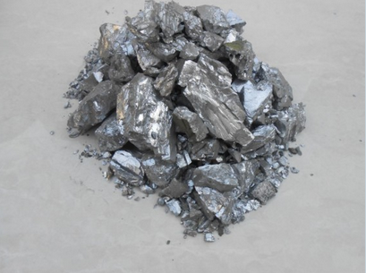
About Chromium
One of the popular alloying elements.
Chromium metal has high hardness.
Chromium oxides at the surface which makes the steel more resistant to corrosion.
This is the reason why high levels (above 12%) of Cr in steels are referred to as stainless steel.
Cr is 20 times more expensive than Fe.

Slide 11
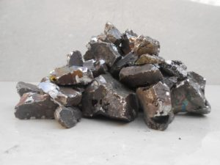
About Manganese
High Mn steels provide an increase in ductility, formability, strain hardening and strength levels
Manganese is used in every steel to increases responsiveness to heat treatment.
In alloy steel, manganese is used to reduce brittleness and improves forgeability, tensile strength and wear resistance. Manganese element is added for better hardenability as it leads to slower quenching rates in hardening techniques.

Slide 12
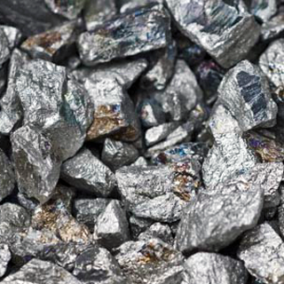
About Nickel
Ni is an important alloying element in steel due to it’s ability to increase the ductility and the toughness and strength of the steel.
Steels with nickel usually have more impact resistance.

Slide 13
Steelmaking Processes
The basic raw material for steel manufacture is either:
hot metal from the production of iron ore in a blast furnace,
steel scrap, or
a mixture of both.

Slide 14
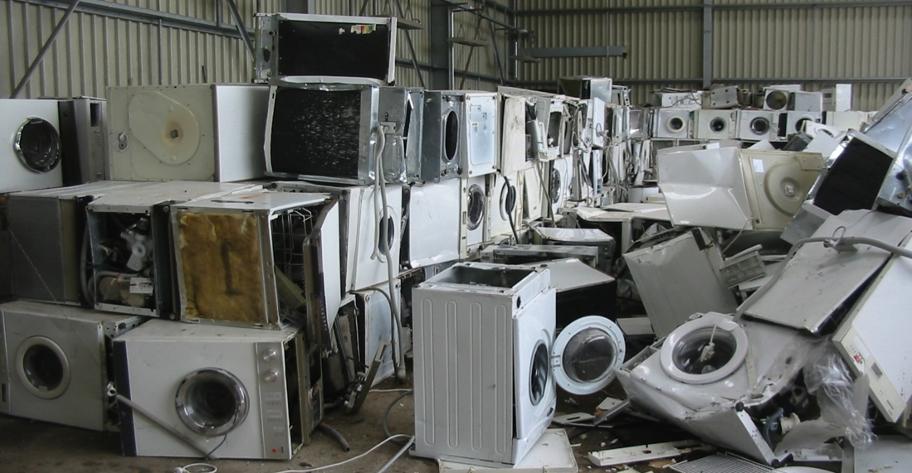
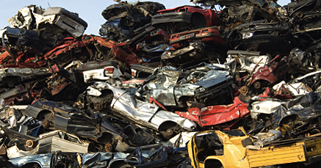
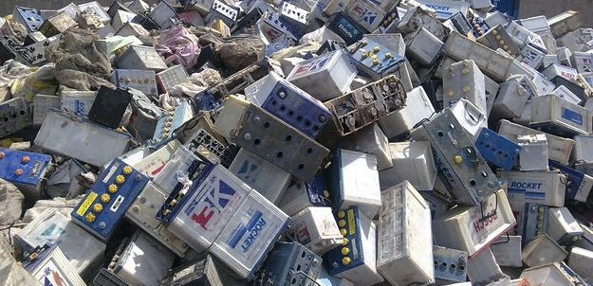

Unprocessed scrap

Slide 15
Collecting Sorting Cutting Bailing Shearing Melting Casting
Processes

Slide 16
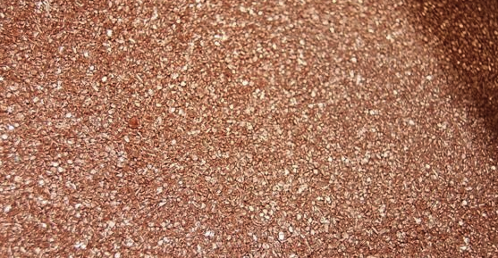
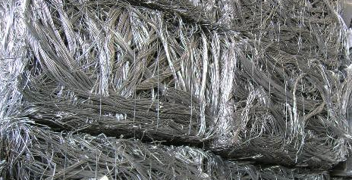
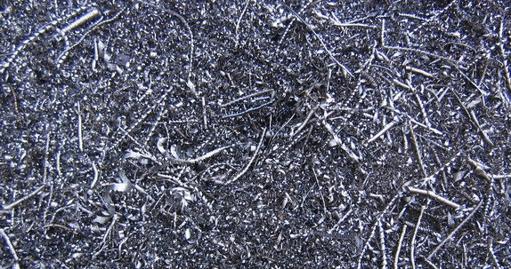
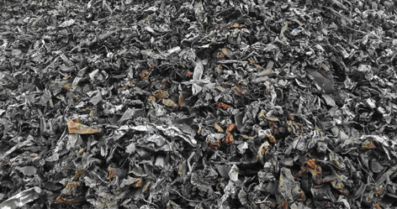
Processed scrap

Slide 17
Next steps:
Manufacturing of Steel specimen and modified specimens using casting equipment and some machining operations.
Specimen Tensile testing under Universal testing machine for Strengths.
Impact test of a specimen.
Microscopic observation of a specimen.
Specimen 3d design in Catia.
Design analysis in Ansys.
Result comparison of all specimens.

Slide 18
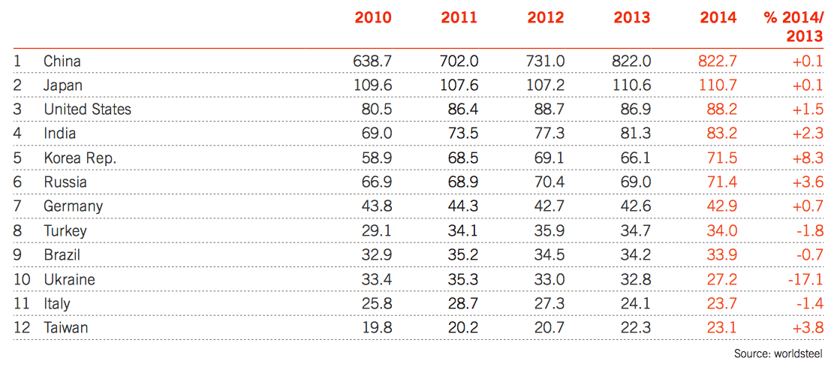
The largest 12 Steel producing countries (Million tonnes)

Slide 19
Continues

Slide 20
THANK YOU

